Slide 1

Data Driven Systems
Web Applications
Data Access – PHP and MySQL
APIS – MySQLi
Lecture 5

Slide 2
Learning Outcomes
You will be able to :
Implement CRUD operations in an MVC web application

Slide 3
CRUD
CRUD is an acronym representing the 4 basic operations between an application and database rccords:
CREATE : Corresponds to SQL INSERT operations
READ : Corresponds to SQL SELECT operations
UPDATE : Corresponds to SQL UPDATE operations
DELETE : Corresponds to SQL DELETE operations
The MVC example code accompanying these lecture notes implement all 4 operations with regard to the MODULES table in the COLLEGE database

Slide 4
Setup
Make sure your Apache server is running – check your XAMPP control panel
In your htdocs folder make sure there is a subfolder for this topic
Eg ..C:/xampp/htdocs/K00999999/T02
Download and unzip the code for this lecture to this folder
Restore the database from the project /database folder
Start NETBEANS
Open the netbeans project for this lecture at this location

Slide 5
T02_L05_MODULES_ADD_EDIT_DELETE
This MVC project has the following additional features versus earlier versions:
The MODULES menu item has been modified to include 3 (dropdown) options:
View/Edit :
To allow a user to select one or ALL modules & view associated data record (CRUD)
To allow a user (LECTURER) to select a module for editing (CRUD)
Add
To allow a user (LECTURER) to create a new module (CRUD)
Delete
To allow a user (LECTURER) to delete a module (CRUD)

Slide 6
Implementation
The following steps were carried out in order to implement the required functions.
Navigation Class and Views: Modified to facilitate new drop down menu items for modules.
LecturerController Class – 4 new ‘handlers’ added for the new menu items (new pageIDs)
Modules Class – Modified to handle each of the new pageIDs corresponding to the CRUD operations
3 new forms were added to the forms/ folder
form_modules_add.html
form_modules_delete.html
form_modules_select.html

Slide 7
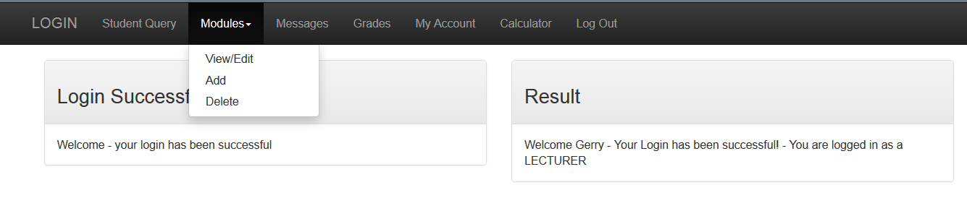
Navigation Class and Views
Views modified to accept a string $menuNav
Navigation class modified to return a STRING containing menu options for the navbar. This was done to permit creation of a drop down menu

Slide 8
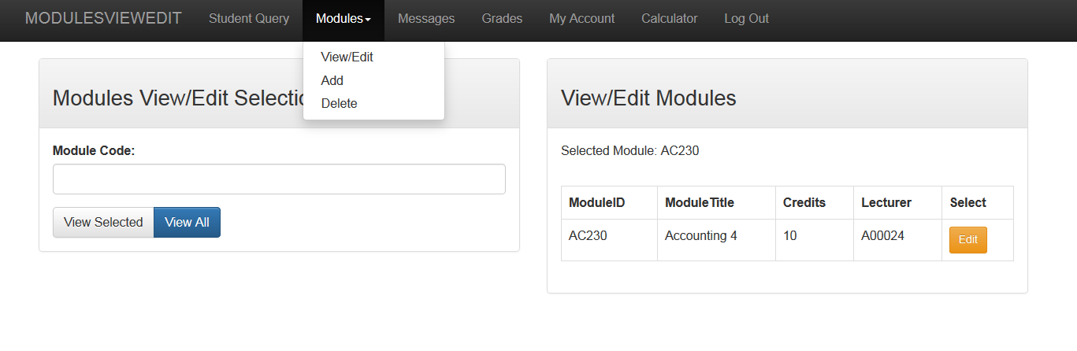
New PageIDs
There are 4 new pageIDs.
Shown below are the names of the new pageIDs and how a user selects them:
modulesViewEdit
modulesAdd
modulesDelete
modulesEdit

Slide 9
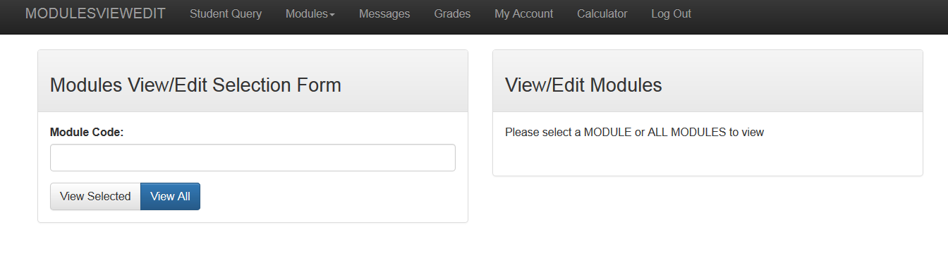
modulesViewEdit
When initially selected ($_POST[‘btn’] is NULL)
The page presents the following form
The user may
enter a single module code and click VIEW SELECTED button
OR click VIEW ALL button to see all modules in the modules table
form_modules_select

Slide 10
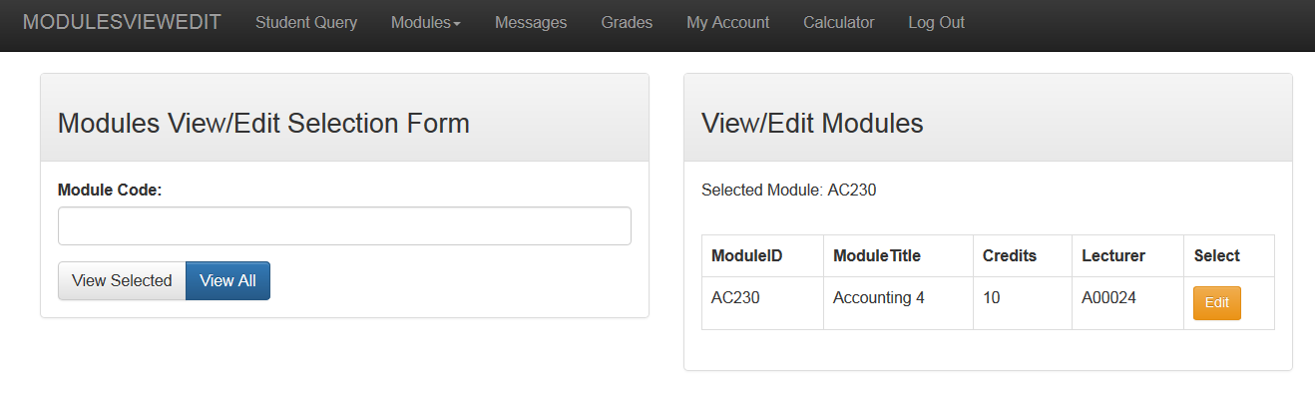
modulesViewEdit
This is the result of clicking VIEW SELECTED button with a valid module code:
The selected data record is retrieved from the modules table and displayed along with an EDIT button. The EDIT button is contained in a form generated by the Modules class when iterating through the query resultset.
The views in these two panels are provided by the Modules Class – see dbViewEditQuery() method for how the result panel on the right is produced

Slide 11
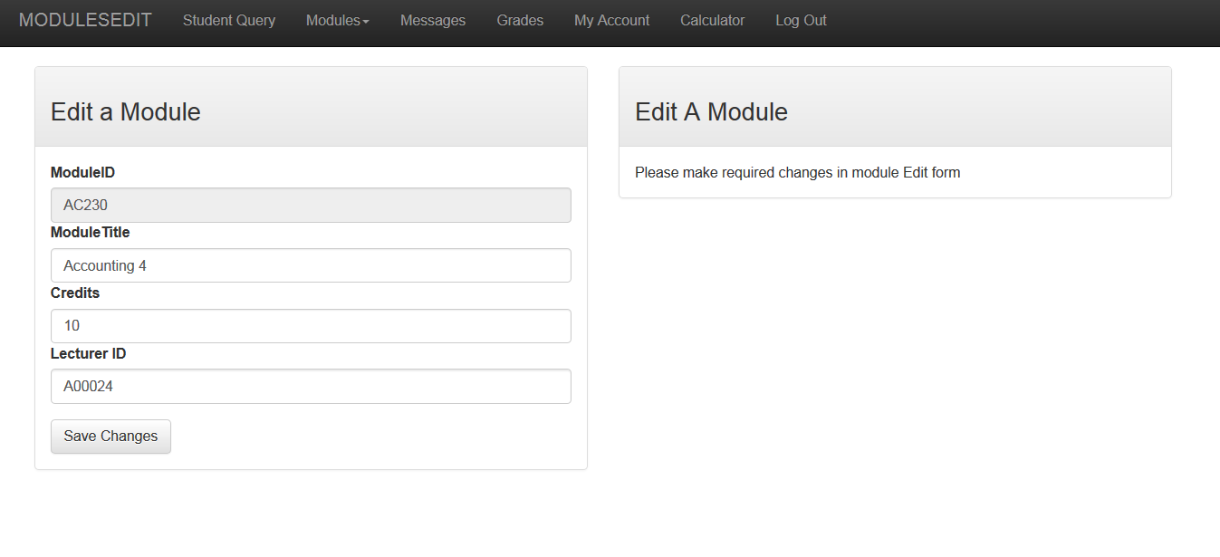
modulesEdit
Clicking the EDIT button beside any module produces the following:
The module edit form is generated by the Modules class after performing a SELECT query in the DB.
The query result is used to ‘populate’ the form with the data from the module data record.
The ModuleID field is deliberately set as read only – see Modules Class dbEditForm() method
Non editable field

Slide 12
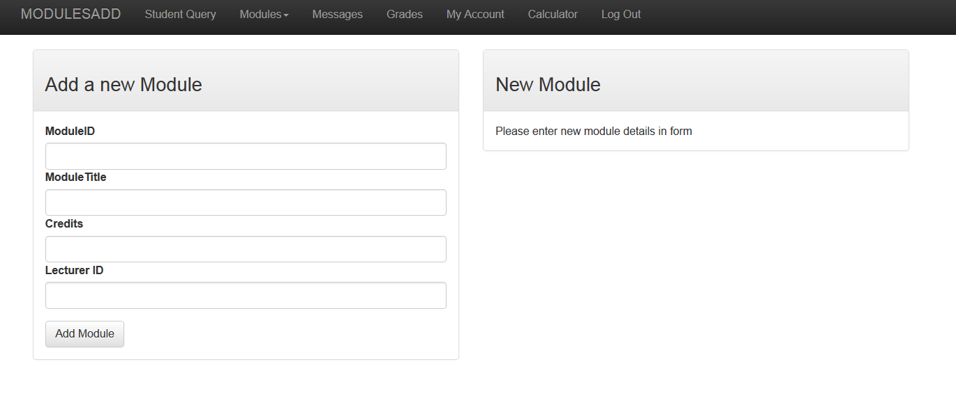
modulesAdd
Clicking the ADD menu option produces the following:
New module details may be entered in the form – if the details entered are valid and the module doesn’t already exist and INSERT SQL statement is executed and the record is added to the modules table.
Confirmation will appear on the right panel
form_modules_add

Slide 13
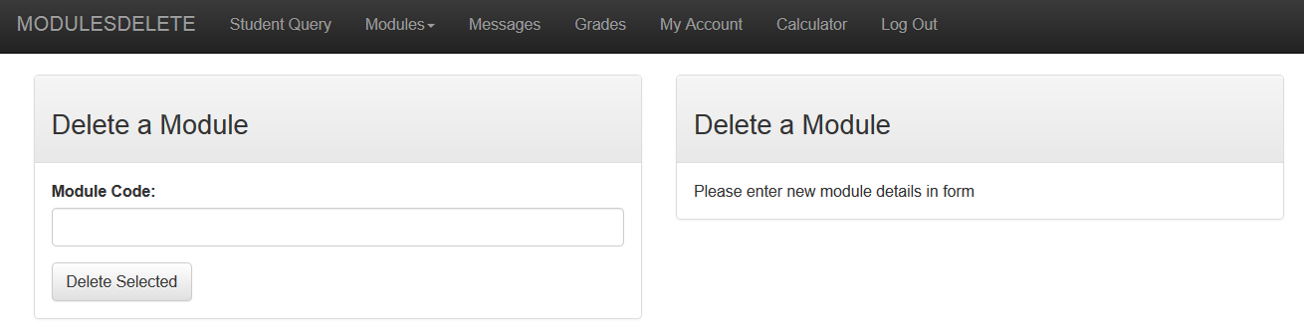
modulesDelete
This menu option allows a user to enter a module code for deletion:
If the module code is valid it will be permanently deleted from the DB and confirmation will appear on the right panel.
form_modules_delete

Slide 14
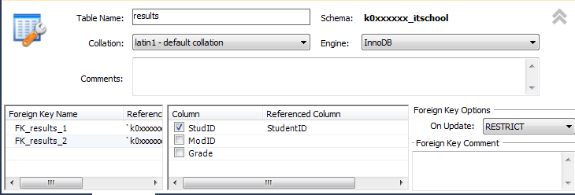
Notes - DELETION restrictions
A record can only be deleted if it does not have any dependant records. For example – to delete a student record – there cannot be any corresponding results in the results table.
This is because the FK relationship between the two tables is specified as RESTRICT on deletion.
To overcome this the relationship should be set to CASCADE on deletion. This will cause the dependant results to be deleted.

Slide 15
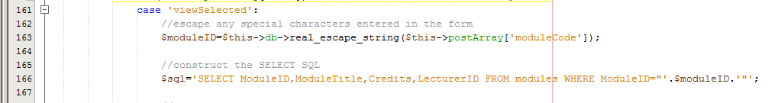
Escaping special characters in user input
Note – it is always necessary to ‘escape’ special characters from any user input.
This can be automatically done using a method provided by the MySQLi object ($db)
The method is used when retrieving any user entered values in a form – see lines 161-166 in Modules Class for example

